Slide 1
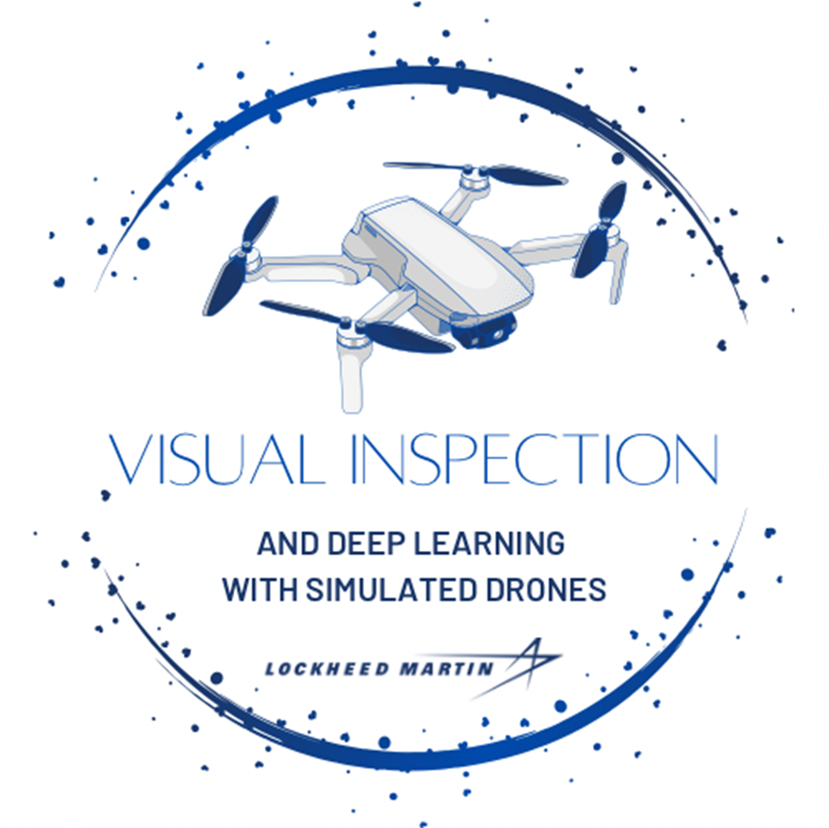
DroneVQA
Team 56
Visual Inspection and Deep Learning
Project Sponsored By Lockheed Martin

Slide 2
Group Members and Task Division
Application
Jennifer Olenchak, Project Manager
Brandon Spangler
AI Models
Robin Perlman, AI Lead
Dataset and Training
Marco Peric, Training Lead
Virtual Test Environment
Samuel Hearn
Ayden Rebhan
J

Slide 3
Project Motivations
Autonomous visual inspection of real-world environments
Drones are ideal candidates
Small size allows maneuvering in varied environments
Easy remote relocation for dynamic perspective
Low-to-high end options widely available
Can self-navigate (Autopilot support)
Simulated drone & environment - real results!
Low-cost proof-of-concept
Research-based focus
Models can be deployed on real drones
Limitless real-world applications
Situation Analysis
Environment Monitoring
Self-inspection
Maintenance Support
Surveys
J

Slide 4
Requirements and Goals
Minimum Viable Product
Use artificial intelligence to visually inspect a simulated environment
Create a Windows application to control the simulation, select models, and record output
Deliver a well-documented GitHub page
Desirables
Polished front end for application
Improve Model Prediction Visualizations
Stretch Goals
Cross platform compatibility for Linux and MacOS
Review even newer models, currently being released, and run a performance analysis
Analyze the performance of fine-tuned versus base models
Streamline dataset creation as a component of the application
Create custom test map to illustrate specific scenarios
B

Slide 5
Budget & Finances
Initially allotted $300
Cost-to-date: $50 used for Unreal assets
Not expecting to spend any additional money
If more budget is used it will go towards more assets
No need to purchase training hardware or cloud training solution
Lent a NVIDIA Quadro RTX 6000 from Lockheed Martin for environment rendering and model training
S

Slide 6









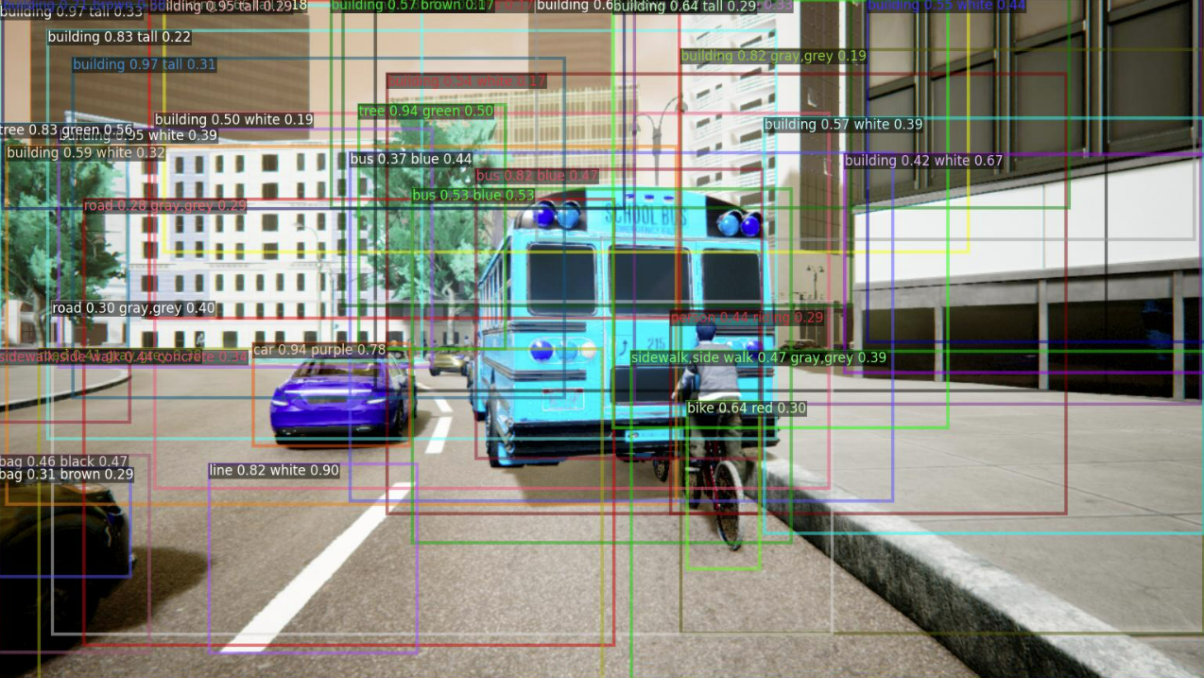
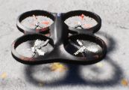
Objectives and Specifications
Create a real-time Visual Question Answering (VQA) system
Visually inspect a virtual environment (Unreal Engine)
Using a simulated quadcopter drone equipped with a camera (Microsoft Air Simulator)
Create a drone control and model interaction interface (QT Creator, Python, Pyside6)
Display explainable AI visualizations
Object detection
Model attention
Compare the performance of open-source VQA models
Create a dataset and train models
Analyze and compare performance
Create custom test map for demonstration
Maintain project organization
Version control (GitHub)
Issue tracking (Jira)
Shared OneDrive
Regular team communication (Zoom & Discord)
A

Slide 7
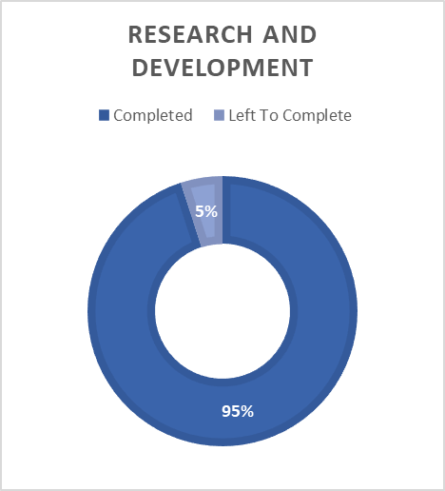
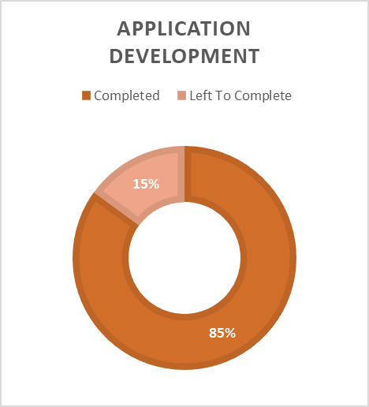
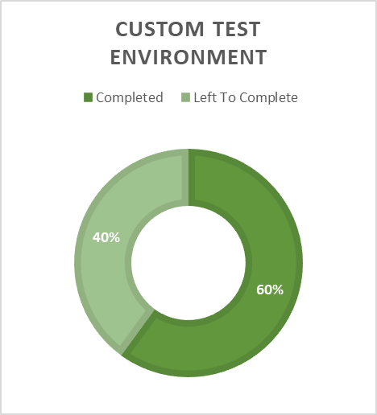
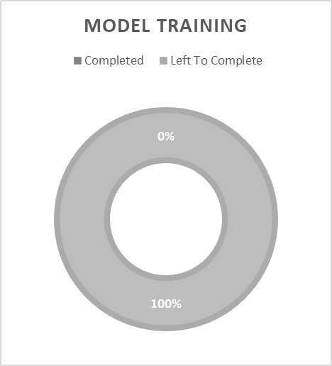
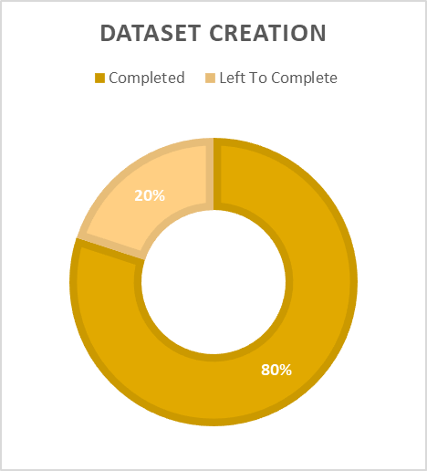
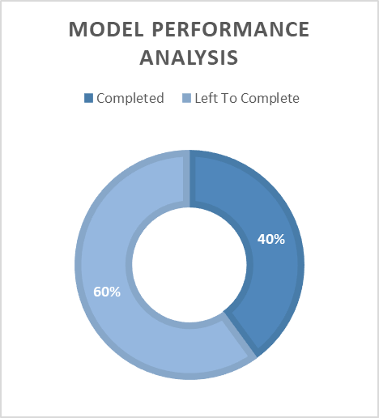
Project Completion By Category
M

Slide 8
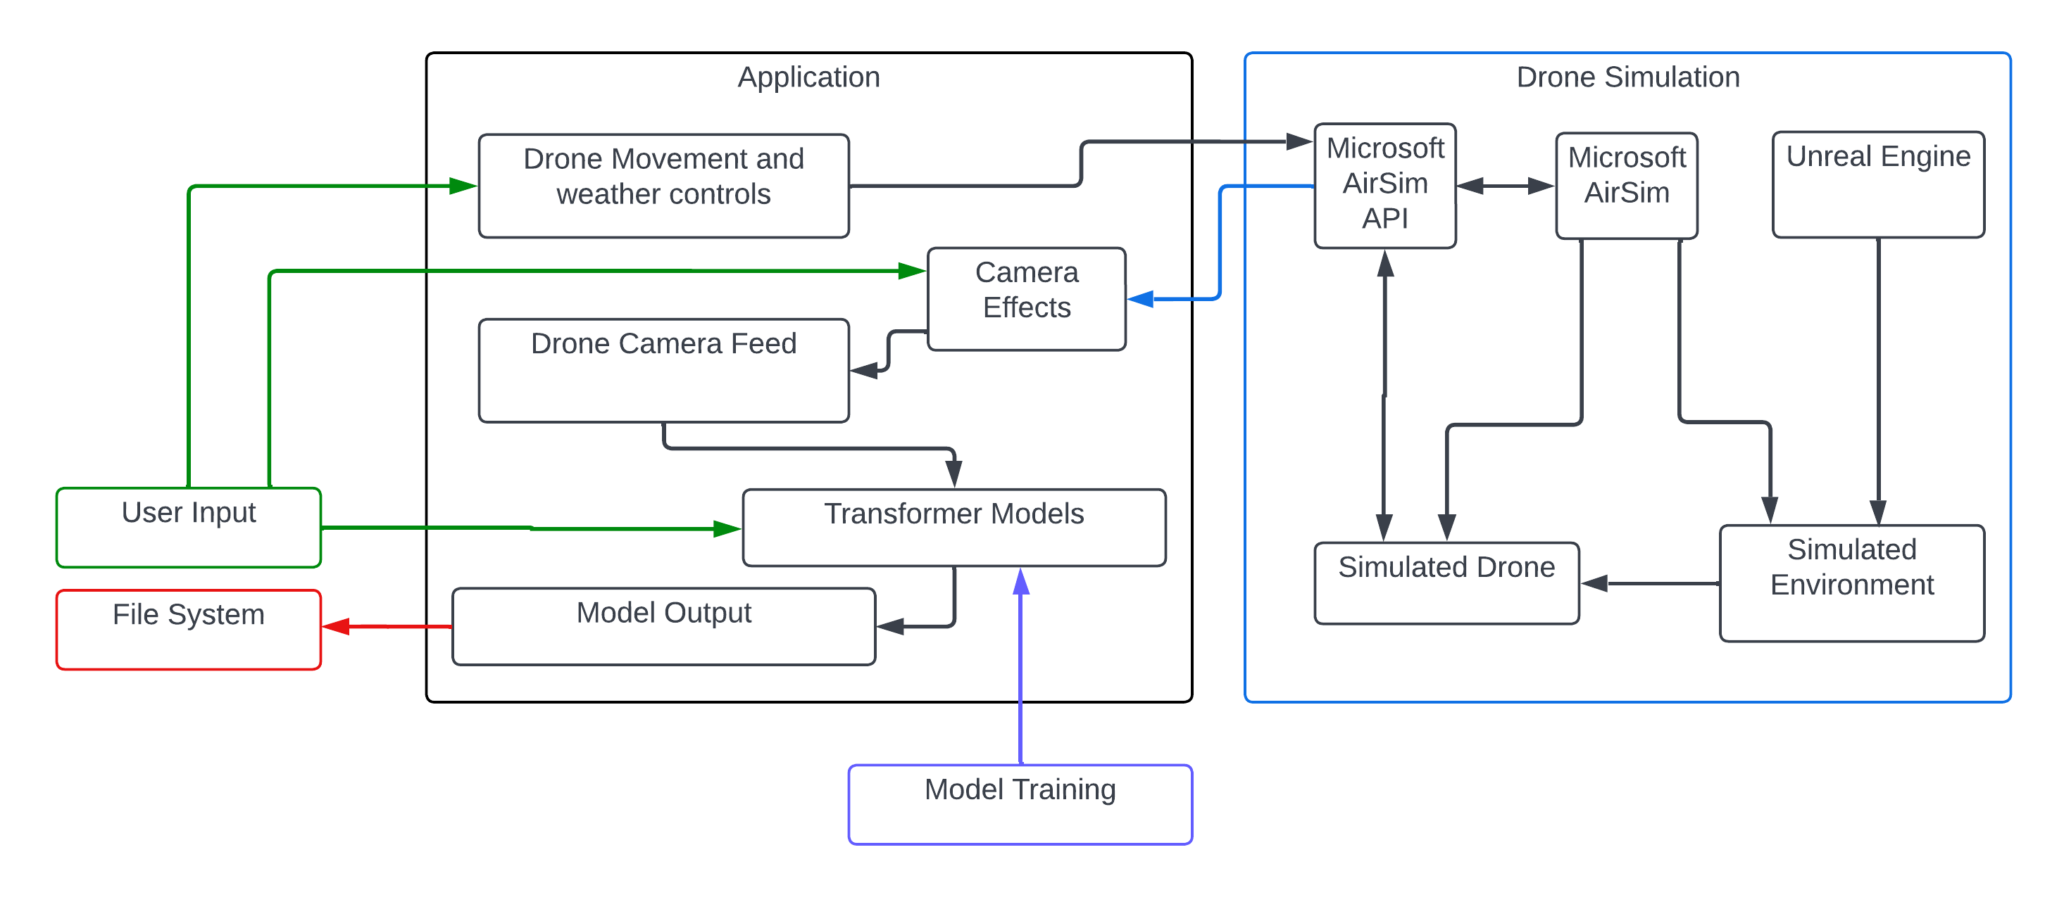
System Diagram
B

Slide 9

Application
Created using QT Creator Software
Drag-and-drop GUI development
.UI design files converted to .py files at runtime
Project-based code launching
Pyside6 library enables QT for Python framework
Cross-platform development - Linux, MacOS, & Windows
One window, two screen approach
Launch and initialization screen
VQA Interaction Screen
Launch Screen
J

Slide 10
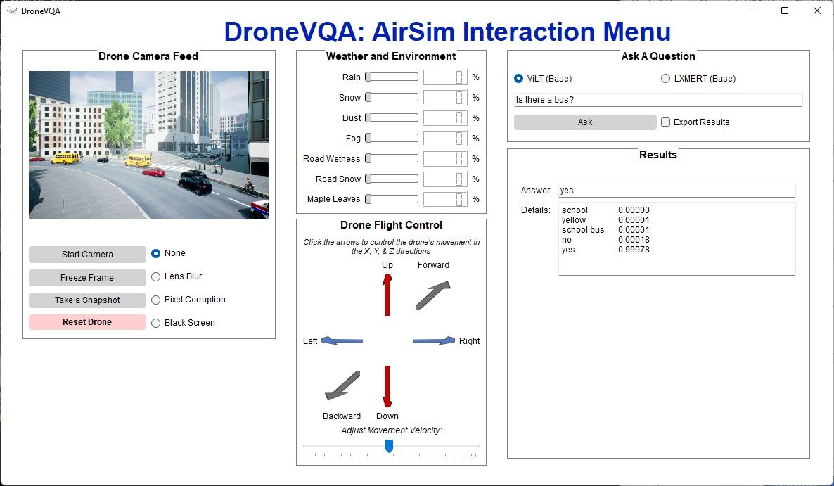
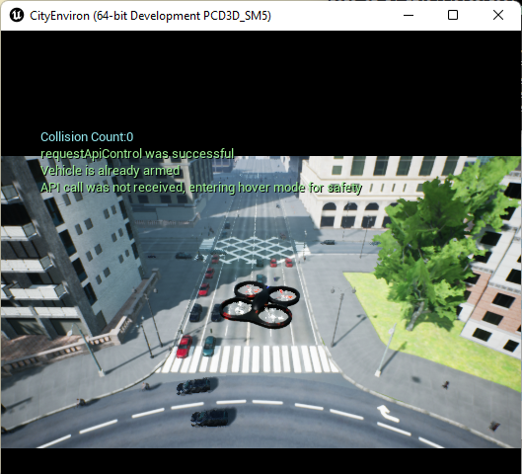
Unreal Engine Executable with Microsoft AirSim Plugin
Application: AirSim Interaction Screen
J

Slide 11
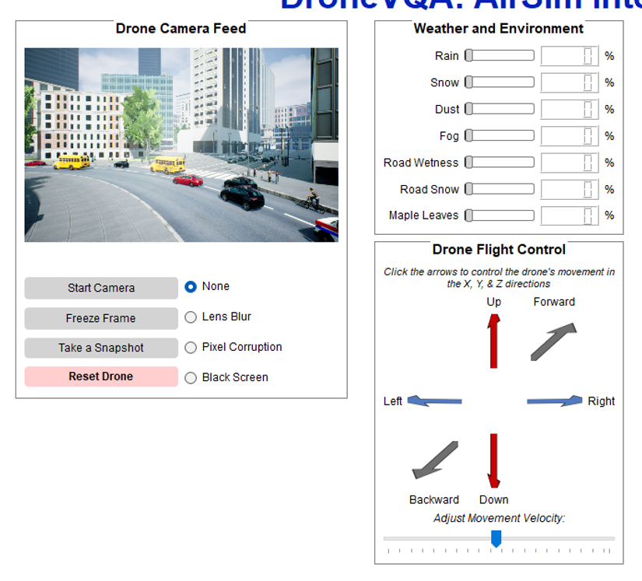
Camera Feed and AirSim APIs Design
Camera Feed Section
Controls
Simple camera controls do not over complicate design
Take a snapshot saves current image to file system
Camera Defect Simulations
Specific camera distortion based on requirements
AirSim APIs
Image API
Used to retrieve image for camera feed and VQA models
Weather APIs
Simulate all different kinds of weather
Flight control APIs
Intuitive XYZ velocity movement
Rotational controls need to be implemented
Gives user full control without needing to directly interact with AirSim
B

Slide 12
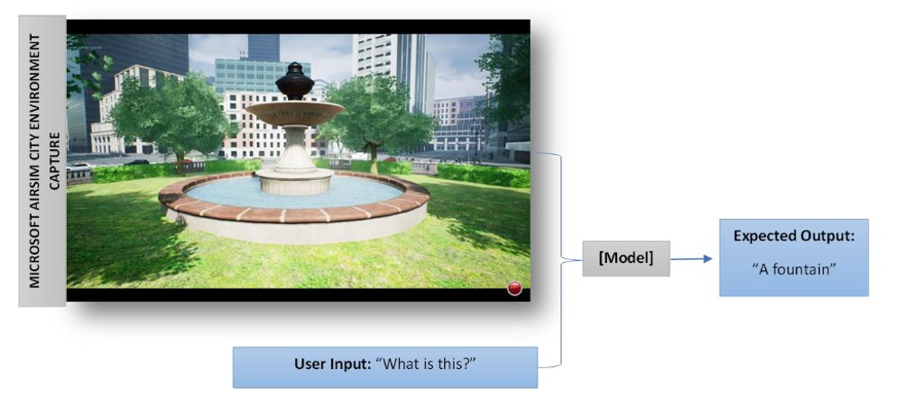
Visual Question Answering (VQA)
VQA is a computer vision task where a model is given a text question about an image, and the model must infer an answer
R

Slide 13
Early VQA Methods
Previous industry-standard for VQA abilities
LSTM (Long Short Term Memory) networks for text featurization
CNN's (Convolutional Neural Networks) for image featurization
Text and image features are then combined in later layers of a Deep Learning network and an answer is produced
Recent emergence of transformer models with the Google research paper "Attention is All You Need" (2017). New models have been developed which can achieve better results on VQA tasks
R

Slide 14
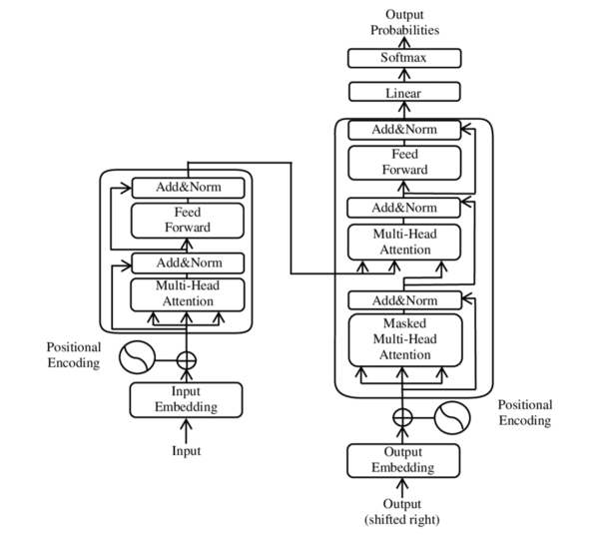
Multimodal Transformers
Transformer models utilize "self-attention" to weigh significant aspects of an input
Transformer models use "positional encoding", and an entire input sequence can be run in parallel (great for speed and scalability)
Encoder / Decoder Architecture
The models we work with only contain encoders
Decoders can be used for generative text
A multimodal transformer combines two or more different types of input data
For us, an image and text are the two inputs
R

Slide 15
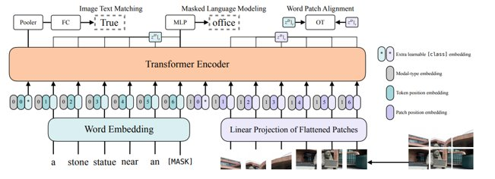
ViLT (Vision-and-Language Transformer)
Model combines text and image input and feeds it through a Transformer Encoder
Finally, a Multi-Layer Perceptron (MLP) is used to obtain an answer
Optimal for speed, due to simplistic architecture
Model is poor for Visual Grounding purposes (aka Visualizations)
R

Slide 16
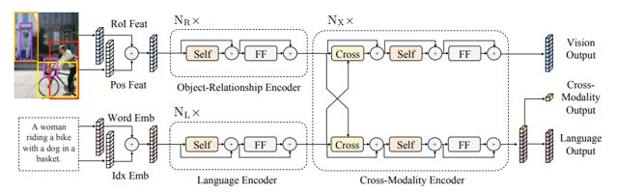
LXMERT (Learn Cross-Modality Encoder Representations from Transformers)
Model utilizes a pre-trained Faster R-CNN (Regional based Convolutional Neural Network) backbone for image features
Model is great for Visual Grounding and is optimal for graphics and visualization data
There is a performance bottleneck due to the Faster RCNN backbone
Optimal for answering multiple questions related to a single image (ex: asking questions about multiple different people in an image)
R

Slide 17
Question Types
The ability to recognize what a given object is by extracting the subject of an image and applying an object detection algorithm
Questions like "What is this?" Or "What am I looking at?"
Text Recognition
The ability to recognize the content of text placed in a scene
Questions like "What text is on that car?" Or "What does that say?"
Object Detection
The ability to detect whether a given object is present in a scene
Questions like "Is this a car?" Or "Is this a building?"
Scene Classification
The ability to classify the category of the scene being presented to the model
Questions like "Where am I?" Or "Is this a city?" Or "What season is this?"
Object Recognition
A

Slide 18
Question Types, cont.
Situation Identification
The ability to gather contextual information about a given scene to identify a situation
Questions like "Is there a traffic jam?" Or "Is this area crowded?"
Attribute Classification
The ability to identify various attributes of a given object or scene
Questions like "What type of car is this?" Or "What color is this car?"
Spatial Reasoning
The ability to form a conclusion using relative spatial concepts
Questions like "are they walking closer?" Or "Is the car far away?"
Counting
The ability to count the number of objects repeated in a given scene
Questions like "How many cars are on this street?" Or "How many people are there?"
A

Slide 19
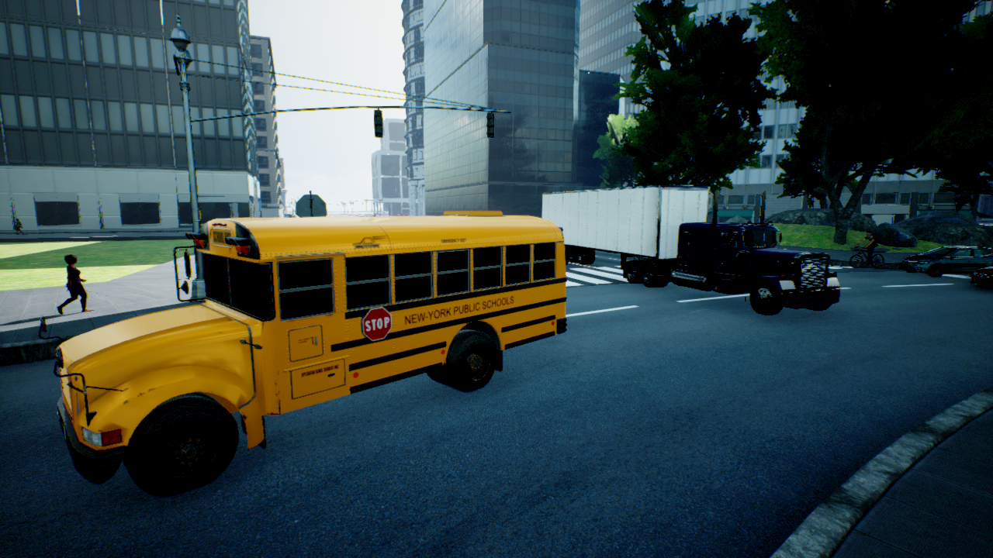
Dataset
To train the models, we are iteratively building the dataset as needed
Images are collected by flying around the test environment
Images are captured at a rate of 24 frames per second and saved as JPGs at a resolution of 1280x720
Meaningful imagery is paired with a list of questions and answers (QA)
Example questions include: "What color is the nearest vehicle?", "What is the weather?" "Are these vehicles travelling towards or away from the camera?"
The questions and answers for each image are specific:
Goal is to improve the model's VQA abilities through temporal, spatial, and relational questions and answers
Currently, the dataset consists of 100 image/QA pairs, but the models may require significantly more data for improvements in accuracy
Considering the use of external computer vision libraries like OpenCV to occlude the imagery – manual labeling would still be necessary
"Are there any people within ten feet of the camera?"
"No"
M

Slide 20

Training the Models
Lockheed Martin provided our team with an NVIDIA Quadro RTX 6000 to accelerate our training
Models are not going to be trained from scratch. Instead, we will fine tune
The fine-tuning performance can be measured by comparing it with the initial test accuracy
The transformer architecture is also prone to overfitting, especially with small inputs. We can monitor this by watching the validation accuracy and loss
The training split may change, but with a smaller data set, more data will be reserved for training, while less data will be used for testing and validation
An 80/10/10 split will be utilized
M

Slide 21
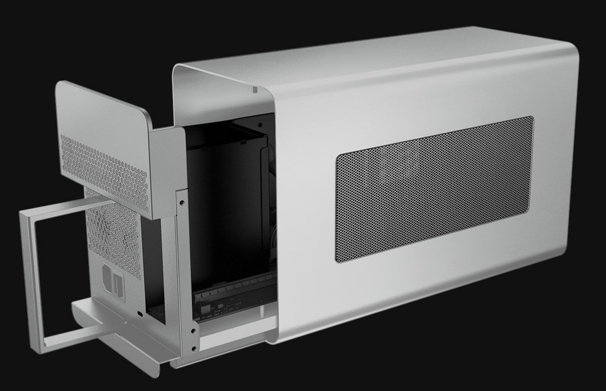
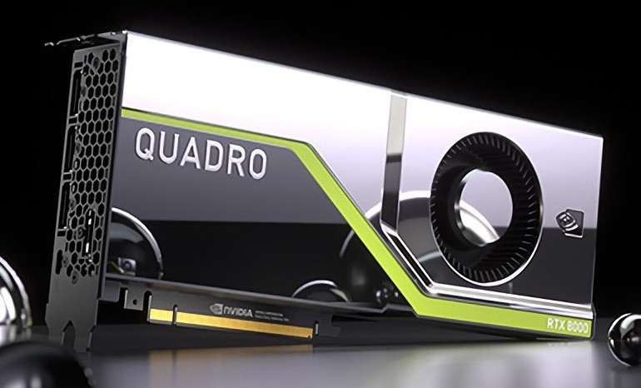
NVIDIA Quadro RTX 6000
The graphics card was lent to us by Lockheed Martin
The card came with a razor eGPU case, so for our training purposes it's plug and play with USB-C
The NVIDIA Quadro RTX 6000 is one of the top graphics cards on the market for AI Training
One of NVIDIA's first RTX series graphics cards designed for AI training and professional use
It flexes some impressive stats that assist greatly in training
24 GB of onboard GPU memory
4,608 CUDA cores – These are parallel processors
576 Tensors cores – These are specialized cores that enable mixed precision training
72 RT (ray-tracing) cores
A

Slide 22
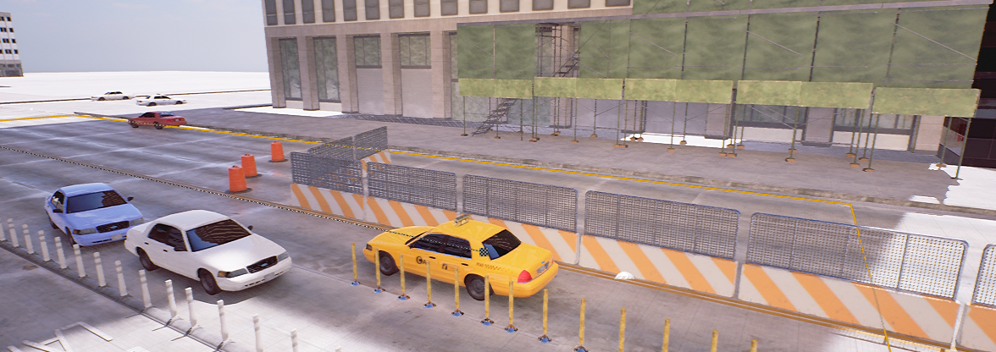
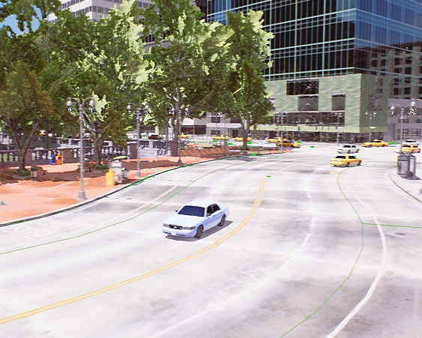
Test Environment
The virtual test environment is made in Unreal Engine 4.27
A custom test environment has been successfully made and used with Air Sim
The environment is made to broaden testing for the model through diversity and control
Constraints include file size and limited methods of sharing
Asset procurement is another difficulty, done though sites providing free assets with credit and paid assets acquired from the budget
S

Slide 23
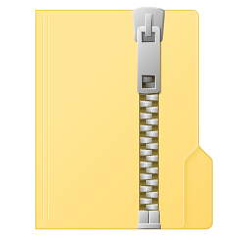
Test Environment: File Size
Current file size is 24 GB unzipped
3.64 GB packaged in an executable file
1.64 GB packaged and zipped
Includes Microsoft Air Sim, other plugins, the project files, and assets
Estimation for the final file size is 40 GB unzipped based on: current percentage progress, used assets, assets still needed to be acquired
Zipped final size will be no more than 5 GB by this estimation
S

Slide 24
Successes & Difficulties
Successes
The PySide library and Qt Creator application have streamlined the GUI creation process
Continuous positive feedback from team sponsors and Lockheed Martin representatives
We demonstrated a proof-of-concept application early in SD1 which paved the way for future goals and breakthroughs
Difficulties
Microsoft stopped development of AirSim in favor of a new closed source project: Project AirSim. As a result, some of the AirSim source code is outdated. Initial setup of the environment proved difficult
Initial research phases took a while as the team was learning about transformer models and how to integrate them into our workflow
The custom simulation environment is so large that it cannot be uploaded to our GitHub repository
Dataset creation must be manual, as Q/A labels must be generated by the human brain
Have successfully created a functional application, custom test environment, base models, and labeled dataset
M

Slide 25
Immediate Plans for Successful Completion
Train
Train the models
Determine if current dataset is large enough
Evaluate
Evaluate training performance
Conclusively determine if training the model improved the accuracy of its prediction
Polish
Polish user interface and experience
Receive third party feedback
Implement additional and improved model visualizations
Tackle
Tackle stretch goals
Refine user experience to provide a clean-cut project deliverables
B

